Slide 1
Audio Recognition system Using Deep Learning
Supervisor, BY,
DR.S. Kannimuthu , Koushikaramakrishnan S
Associate Professor Guru Prasath S R
Department of cSE Jeevanandham k

Slide 2
Abstract
Audio Recognition has number of applications in different areas of engineering and day-to-day aspects. Nowadays it is being used in health care, telephony military and people with disabilities.
The main objective of the system is to provide support to military professionals, security from unwanted intruders within military camps. The objective is achieved through processing the voice data within the military camps and recognizing the unwanted intruders.
The voice is processed using convolutional neural networks, which is applied on the spectrogram of the audio sample. If an unauthorized voice sample is found, the concerned officials are intimated.
At the initial effort is made to provide the basic operations as discussed above, the model is trained with multilayer perceptron. And to enhance the model, convolutional neural network (CNN) is used.
The speech waves of particular voice form the basis of identification of speaker. The voice features which are extracted are compared with already saved voices in the database for matching. This paper provides review of various voice and speaker recognition systems. .

Slide 3

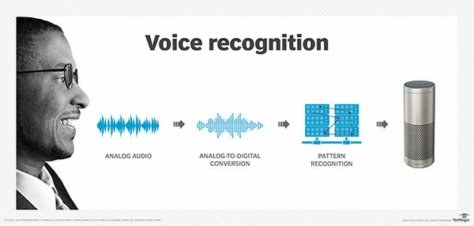
Audio Recognition
Fig 1: Analog to Digital Signal Conversion

Slide 4
Power of Sound
Sounds are all around us. Whether directly or indirectly, we are always in contact with audio data. Sounds outline the context of our daily activities, ranging from the conversations, listening music and all environmental sounds such as sound of the car, rain, hammer etc..,
The human brain is continuously processing and understanding the audio data consciously or subconsciously, giving us information about the environment around us

Slide 5
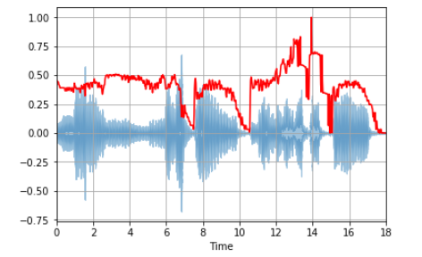
How Is It Done?
Audio signal classification system analyzes the input audio signal and creates a label that describes the signal at the output. These are used to characterize both music and speech signals. The categorization can be done on the basis of pitch, music content, music tempo and rhythm.
Fig 2: Audio Signals

Slide 6
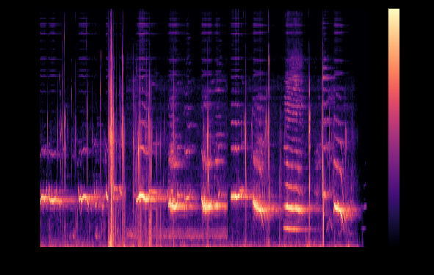
Spectrogram
Spectrograms represent the frequency content in the audio as colors in an image. Frequency content of milliseconds chunks is stringed together as colored vertical bars. Spectrograms are basically two-dimensional graphs, with a third dimension represented by colors.
Fig 3: Spectrogram

Slide 7
Spectrogram
Time runs from left (oldest) to right (youngest) along the horizontal axis.
The vertical axis represents frequency, with the lowest frequencies at the bottom and the highest frequencies at the top.
The amplitude (or energy or “loudness”) of a particular frequency at a particular time is represented by the third dimension, color, with dark blues corresponding to low amplitudes and brighter colors up through red corresponding to progressively stronger (or louder) amplitudes.

Slide 8
Problem Statement
This Project will demonstrate how to apply Deep Learning techniques to the classification of environmental sounds, specifically focusing on the identification of particular urban sounds.
When given an audio sample in a computer readable format (such as a .wav file) of a few seconds duration, we want to be able to determine if it contains one of the target urban sounds with a corresponding Classification Accuracy score.

Slide 9
Related Works
“A Dataset and Taxonomy of Urban Sound Research” (Salamon, 2014). The paper describes five different algorithms with the following accuracies for a audio slice maximum duration of 4 seconds using the same Urban Sound dataset.
Algorithm | Classification Accuracy
SVM_rbf | 68%
RandomForest500 | 66%
IBk5 | 55%
J48 | 48%
ZeroR | 10%

Slide 10
Specifications
Hardware Specification
Intel i5 processor or higher
Minimum 8 GB RAM
256 GB hard drive
Software Specification
Jupyter Notebook
Pycharm
Python 3 or higher versions
PyPi Libraries
Numpy
Pandas
Scikit
Keras
MatplotLib
Librosa

Slide 11
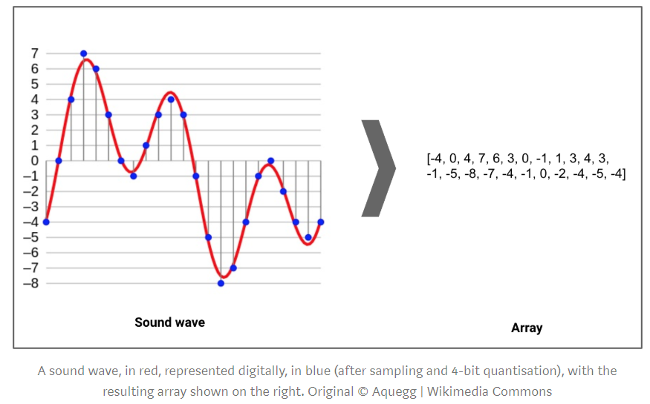
Audio properties
These audio properties for preprocessing to ensure consistency across the whole dataset:
Audio Channels
Sample rate
Bit-depth
Librosa library will be useful for the pre-processing and feature selection.

Slide 12
Feature Extraction
Feature extraction. is used in determining a subset of the initial features is called feature selection.
The selected features are expected to contain the relevant information from the input data, so that the desired task can be performed by using this reduced representation instead of the complete initial data.

Slide 13
Extraction Methods
Linear Predictive Coding (LPC):
Perceptual Linear Prediction (PLP)

Slide 14
Proposed Approach MFCC
The MFCC ( Mel-Frequency Cepstral Co-efficients ) summarises the frequency distribution across the window size, so it is possible to analyze both the frequency and time characteristics of the sound. These audio representation will allow us to identify features for classification.
For extracting a MFCC, we will use Librosa’s mfcc() function which generates an MFCC from time series audio data.

Slide 15
MFCC
Mel-frequency cepstral coefficients (MFCCs) are coefficients that collectively make up an MFC.
They are derived from a type of cepstral representation of the audio clip (a nonlinear "spectrum-of-a-spectrum").
The difference between the cepstrum and the mel-frequency cepstrum is that in the MFC, the frequency bands are equally spaced on the mel scale, which approximates the human auditory system's response more closely than the linearly-spaced frequency bands used in the normal cepstrum

Slide 16
Data Exploration
For this project we will use a dataset called Urbansound8K. The dataset contains 8732 sound excerpts (<=4s) of urban sounds from 10 classes, which are:
Air Conditioner
Car Horn
Children Playing
Dog bark
Drilling
Engine Idling
Gun Shot
Jackhammer
Siren
Street Music
The accompanying metadata contains a unique ID for each sound excerpt along with it’s given

Slide 17
Sample Audio WaveForm

Slide 18
Initial Architecture MLP
A multilayer perceptron (MLP) is a class of feedforward artificial neural network (ANN).
The term MLP is used ambiguously, sometimes loosely to refer to any feedforward ANN, sometimes strictly to refer to networks composed of multiple layers of perceptrons.
An MLP consists of at least three layers of nodes: an input layer, a hidden layer and an output layer. Except for the input nodes, each node is a neuron that uses a nonlinear activation function.
MLP utilizes a supervised learning technique called backpropagation for training.
In the Multilayer perceptron, there can more than one linear layer. If we take the simple example the three-layer network, first layer will be the input layer and last will be output layer and middle layer will be called hidden layer.
We feed our input data into the input layer and take the output from the output layer. We can increase the number of the hidden layer as much as we want, to make the model more complex according to our task.

Slide 19
Initial Architecture MLP
Starting with a sequential model so new can build the model layer by layer.
We will begin with a simple architecture , consisting of three layers, a input layer,a hidden layer,and an output layer.
The first layer will receive the input shape . Each input sample contains 40 MFCC’S which means we start with a shape of 1X 40.
The first two layers will have 256 nodes.The activation function used is Rectified Linear Activation. The ReLU is chosed as it is proven for good record with working on neural networks.
The output layer will have the count of differente classes used in the training data.The activation used for output layer is Softmax as it reduces the values to probabilitites.
The class is derived or classified with the probability values, , i.e, The higher the probability the more the likeliness of being that class.

Slide 20
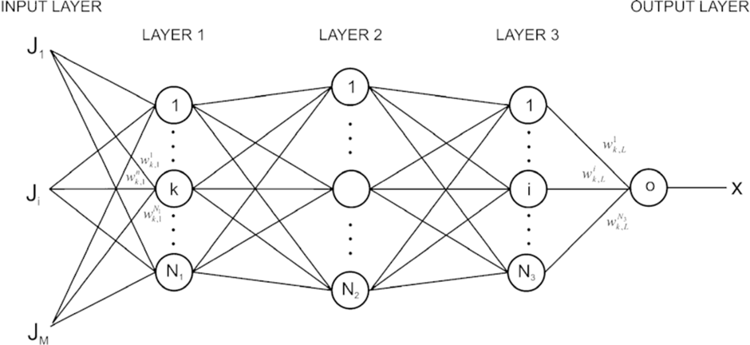
MLP-Multi Layer Perceptron
Fig 4: Multi Layer Perceptron Architecture

Slide 21
Final Architecture - CNN
In deep learning, a convolutional neural network (CNN, or ConvNet) is a class of deep neural networks, most commonly applied to analyzing visual imagery.
They are also known as shift invariant or space invariant artificial neural networks (SIANN) .
The name “convolutional neural network” indicates that the network employs a mathematical operation called convolution.
Convolution is a specialized kind of linear operation.

Slide 22
CNN - Working
The model is modified to Convolutional Neural Network (CNN) again using Keras and a Tensorflow backend.
The convolution layers are designed for feature detection. It works by sliding a filter window over the input and performing a matrix multiplication and storing the result in a feature map.
The activation function we will be using for our convolutional layers is ReLU which is the same as our previous model.
We will use a smaller Dropout value of 20% on our convolutional layers.
Each convolutional layer has an associated pooling layer of MaxPooling2D type with the final convolutional layer having a GlobalAveragePooling2D type.
The pooling layer is do reduce the dimensionality of the model which serves to shorten the training time and reduce overfitting.
The output layer will have 10 nodes .
The activation is for our output layer is softmax.
Softmax makes the output sum up to 1 so the output can be interpreted as probabilities. The model will then make its prediction based on which option has the highest probability.

Slide 23
Convolutional Neural Network

Slide 24
MLP Vs CNN
Feature | MLP | CNN
Training Accuracy | 92% | 98%
Testing Accuracy | 87% | 91%
Training Time | 40 mins | 4 hrs
Data Size | 8732 records | 8732 records
Loss value | 0.39 | 0.11
Run Time | 0:00:02.92 | 0:00:01.79

Slide 25
Applications
Content-based multimedia indexing and retrieval
Assisting deaf individuals in their daily activities
Smart home use cases such as 360-degree safety and security capabilities
Industrial uses such as predictive maintenance.
Authorized Entry Recognition in military camps
Security For visually differed People

Slide 26
Conclusion
The audio recognition methodology used here would produce higher degree of accuracy than in the previous models.
The use of MFCC over traditional spectrograms paves way to a lot of new features to be described on the audio samples. These new features provides a lot of clarity to the models to be used.
This project when fed with a noise less audio sample provides almost near perfect classifications.
The project when trained with a Multi Layer Perceptron- MLP provides an accuracy of ~92% on the training data and ~ 87 % on the test data. The model is further enhanced when using a convolutional neural network. i.e, The training accuracy in CNN is ~98% which is huge increase over the MLP accuracy and also significant rise of 5% is shown in the test data ~92%.
For Further fine tuning and for the usage in real world applications the audio samples must at first be cleared of noises, the noises can be cleared using pre-existing machine learning algorithms.

Slide 27
References
[1]. Justin Salamon, Christopher Jacoby and Juan Pablo Bello. Urban Sound Datasets. https://urbansounddataset.weebly.com/urbansound8k.html
[2]. Mel-frequency spectrum Wikipedia page.
[3]. Justin Salamon, Christopher Jacoby and Juan Pablo Bello. A dataset and taxonomy of urban sound search. http://www.justinsalamon.com.uploads/4/3/9/4/4394963/salamon_urbansound_acmmm14.pdf
[4]. Manik Soni AI which classifies sounds: code: Python. https://hackernoon,com/ai-which-classifies-sounds-code-python
[5]. Urban Sound Classification – Part 2: Sample rate conversion, Librosa. https://towardsdatascience.com
[6]. Audio Source: http://soundbible.com
[7]. Speech Recognition Using Deep Neural Networks: A Systematic Review https://ieeexplore.ieee.org/document/8632885/footnotes#footnotes

Slide 28
Thank You.

